Slide 1
San Francisco Food Security Task Force (FSTF)
Strategic Plan (SP) for Multi-Sector Collaboration to Ensure Food Security
in San Francisco
SP Implementation Work Group Meeting
February 5, 2020

Slide 2
Meeting Objectives
Discuss, and make revisions to, draft project charter for this work group
Continue the evaluation phase of Priority 4: Information and Referrals
Determine next steps for Priority 4: Information and Referrals

Slide 3
Agenda
Welcome, Introductions, Approval of Minutes, Action Items (10 min.)
Project Charter (25 min.) - Discussion
Priority 4: Information and Referrals (50 min.) - Discussion
Public comment, Wrap up (5 min.)
Vision: Food Secure San Francisco
1.Sustainability (human and financial)
(FSTF
Driven)
2.Shared Measurement
(FSTF
Driven)
3.Adequate Community Resources
(Multi-Stakeholder Driven)
4.Information and Referrals
(Multi-Stakeholder Driven)

Slide 4
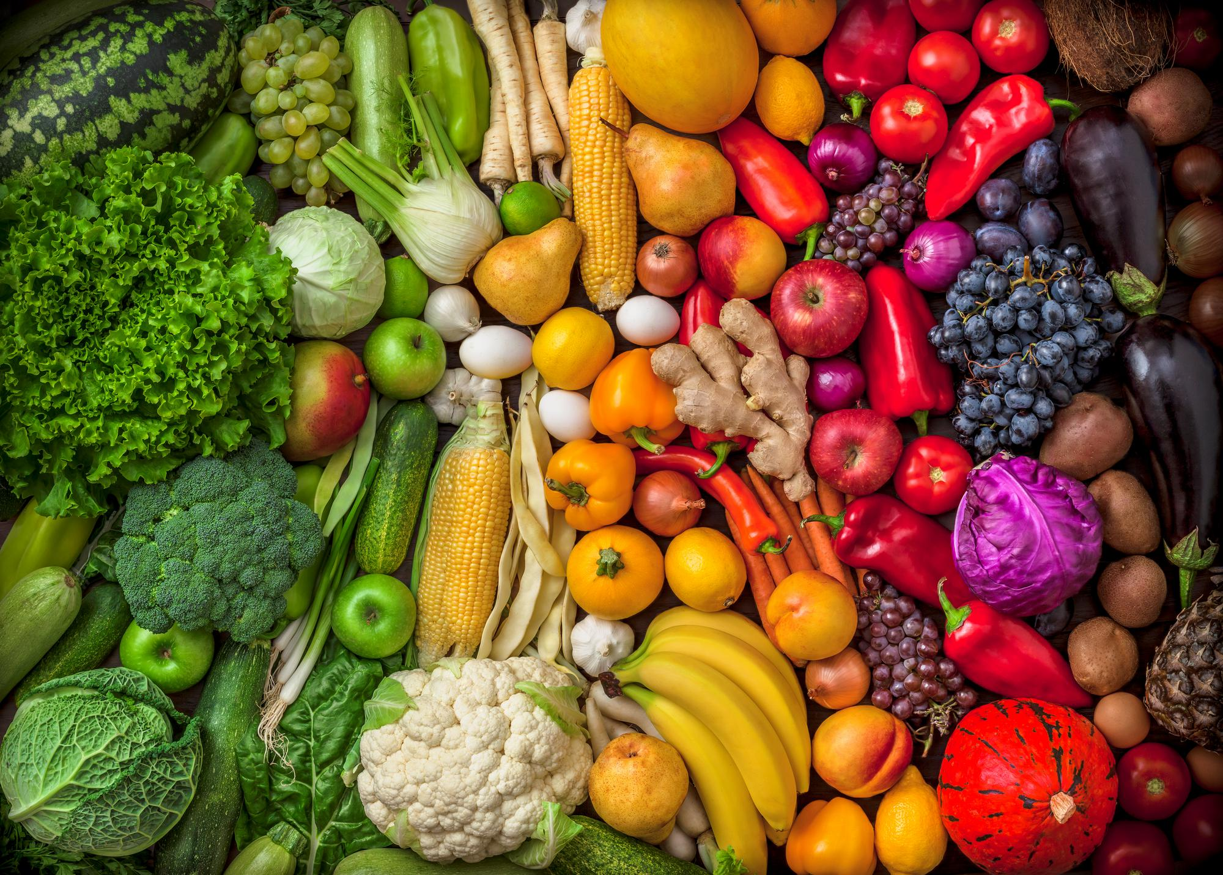
Minutes and Action Items from Last Meeting
Specific Action Items (AIs) included in minutes
All: Continue to share I&R resources with with CalFreshIntern@sfmfoodbank.org
List of I&R Tools/System
Name | Type | Website
211 Bay Area | System | https://www.211bayarea.org/
DAS resource Hub | System | https://www.sfhsa.org/services/access-empowerment/das-benefits-and-resources-hub
Food Locator-SFMFB | Tool | https://foodlocator.sfmfoodbank.org/
Link-SF | System | https://link-sf.com/
Free Print Shop | System | http://www.freeprintshop.org/

Slide 5
Discussion: Project Charter for Work Group
Review draft – Thank you, Kathleen Reed!
Questions for Discussion
What should our measurable objectives be for each priority?
Should we solicit point people for Priorities 1, 3, and 4?
Timeframe (charter go through Dec 2020 or Jan 2012?)
How formal should we be in terms of membership in the work group?

Slide 6
Discussion: Priority 4: Information and Referrals (I&R)
Review Handout
Strategic Planning output and progress made in Work Group
Referral Advocates: FSTF to champion the need for food to be included in all existing referral efforts and process(es) (i.e., DPH Resource & Referral), while advocating for bi-directional feedback, client evaluation, and multi-generational approach.
Process
Evaluate
Learn from I&R stakeholders
Identify key challenges
Understand Challenge(s)
Research best practices
Generate possible solutions
Determine Best Ways to Support
Make recommendations
Advocate
Participate in pushing solutions forward

Slide 7
Next Steps in Evaluation Phase
Engage stakeholders that provide food-related I&R to learn about their experience, what’s working, challenges, and needs
211 Bay Area
Food Locator - SFMFB
DAS Benefits and Resources Hub
Questions for stakeholders
What are the key challenges in providing food referrals?
What are the future priorities or changes coming in I&R?
How is success being defined for I&R and measured? Is there currently a feedback loop?
What are the needs of I&R for food in SF?

Slide 8
Wrap up
Public Comment
Next Steps

Slide 9
4. Information and Referrals Next Steps
Multi-Stakeholder driven next steps:
Year 1 & 2:
Referral Advocates: FSTF to champion the need for food to be included in all existing referral efforts and process(es) (i.e., DPH Resource & Referral), while advocating for bi-directional feedback, client evaluation, and multi-generational approach.
Best Practices Analysis: FSTF/others to research best practices from other/current information referral efforts including: Our Children Our Families Council SF (OCOF) service inventory group, 211 in San Diego, DPH’s efforts to update resources and referral around food, etc.
Longer-Term:
Seat at the Table: FSTF (or emergent structure) will participate in a multi-stakeholder Information & Referrals approach to:
Key Actors: Determine key actors/stakeholders to structure the initiative
Implementation Plan: Engage actors/agencies to develop a user-journey for current I&R system, develop a vision for seamless I&R, prototype & iterate, secure funding.

